Slide 1

Ensemble Methods – Part 2
Data Mining– Final Week 1
Humaira Anzum Neha
Lecturer
Dept of CSE, UIU
humaira@cse.uiu.ac.bd

Slide 2

Ensemble Methods
Boosting
AdaBoost

Slide 3
Boosting
How boosting works?
  A series of k classifiers are iteratively learned
  After a classifier M_{i} is learned, set the subsequent classifier, M_{i+1}, to pay more attention to the training tuples that were misclassified by M_{i}
  The final M* combines the votes of each individual classifier, where the weight of each classifier's vote is a function of its accuracy

Slide 4
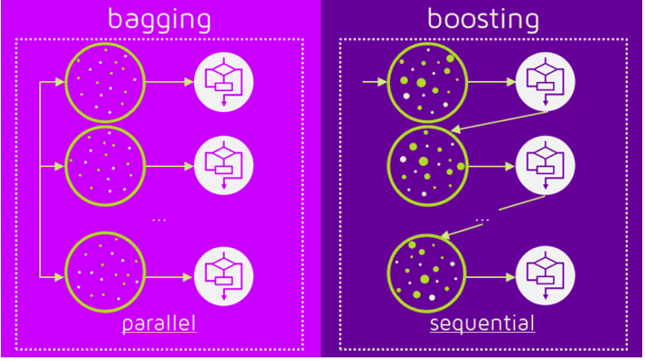
Bagging vs Boosting

Slide 5
Random Forest vs AdaBoost
Factors | Random Forest | AdaBoost
Learning Process | Parallel: Trees are built independently and simultaneously. | Sequential: Trees are built one after another, each correcting the errors of the previous one.
Model Weights | All trees have equal weight in the final prediction. | Trees are weighted based on their performance; better-performing trees have more influence.
Tree Complexity | Fully grown decision trees with many splits. | Simple decision stumps with only one split (root and two leaves).
Strength of Models | Strong individual models (complex trees). | Weak individual models (simple stumps), combined for better performance.
Main Focus | Reducing overfitting by building diverse trees. | Reducing errors by focusing on the mistakes of previous trees.

Slide 6
AdaBoost
Boosting Algorithm
Short for Adaptive Boosting - higher weights are assigned to the data points which are miss-classified or incorrectly predicted by the previous model. This means each successive model will get a weighted input.
Always works better
Combines multiple weak learners to generate a powerful model
Weak learners - An ML algorithm that’s accuracy is less than 50% or nearly 50%.
Strong Learners - 95-99%

Slide 7
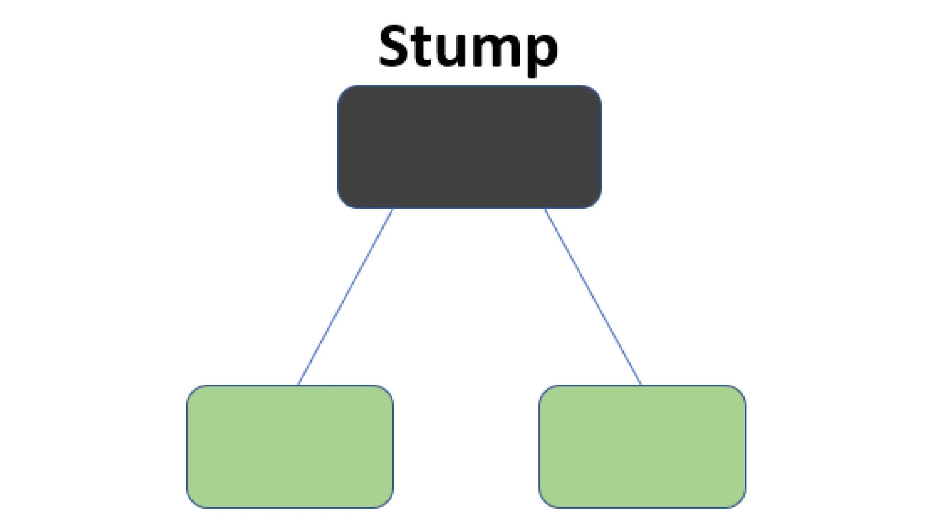
AdaBoost
Base Model – Weak Learners

Slide 8
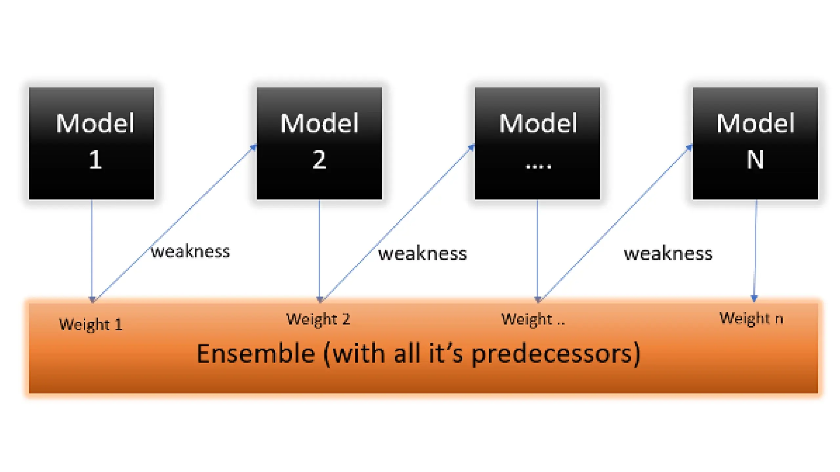
AdaBoost
Base Model – Weak Learners

Slide 9
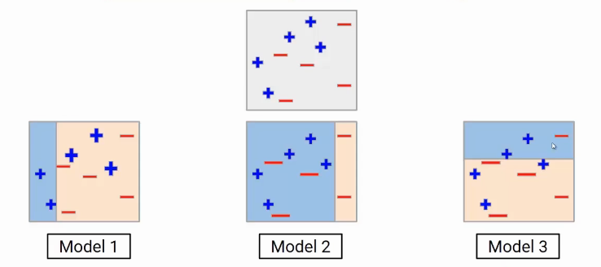
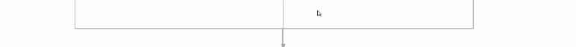

AdaBoost
Notes:
What is AdaBoost?
AdaBoost is a type of boosting algorithm that focuses on building a strong model by combining several weak models. The key idea is to train models sequentially, with each model focusing on correcting the errors made by the previous one.
How AdaBoost Works:
Start with a Weak Model:
The first model (Model 1) is trained on the data. It’s a simple model that may not do a great job of classifying everything correctly. Some points are classified correctly (in blue), while others are misclassified (in red).
Give More Weight to Misclassified Points:
After the first model is trained, the algorithm looks at which points were classified incorrectly. These misclassified points are given higher weights, meaning the next model (Model 2) will focus more on them. The idea is to fix the mistakes of the first model.
Train the Next Model:
Model 2 is now trained, with more attention given to the points that were misclassified by Model 1. Again, some points may still be misclassified, and the weights of these points are adjusted for the next round.
Repeat for Multiple Models:
This process continues for several rounds (in this case, Model 3 is the third model in the sequence). Each new model focuses on the mistakes made by the previous models.
Combine the Models:
Finally, all the models are combined to make the final prediction. In AdaBoost, the models are combined in a weighted manner, meaning models that performed better will have more influence on the final decision. This is shown in the bottom image where all models work together to improve the final classification.
Key Points of AdaBoost:
Boosting weak models: Each model is a "weak learner" (like a simple decision tree), but together they become a "strong learner."
Focus on errors: AdaBoost gives more importance to data points that were misclassified in previous rounds.
Sequential training: Models are trained one after another, with each model improving on the previous one.
Example:
Think of it like a team of tutors helping you study for an exam. The first tutor teaches you some basics, but you still make some mistakes. The second tutor focuses on what you got wrong the first time, and the third tutor builds on that. By the end, all the tutors' help combines to give you a much better understanding.
This is the basic idea behind AdaBoost—each model corrects the previous one’s mistakes, and in the end, they work together to give a much better overall performance.

Slide 10

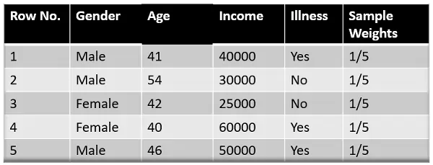
AdaBoost – Step by Step
Step 1: Assigning Weights
  All data points will be assigned some weights. Initially, all the weights will be equal.
  The formula to calculate the sample weights is:
  Where N is the total number of data points
Notes:
Step 1: Assign Initial Weights
All data points get equal weight at the start.
Step 2: Train a Weak Learner
Train a simple model (like a decision stump) on the data.
Step 3: Calculate the Error
Find out how many points the model misclassified.
Step 4: Update the Weights
Increase the weights of the misclassified points to make them more important for the next model.
Step 5: Normalize the Weights
Adjust the weights so that their total equals 1.
Step 6: Train a New Model
Train a new weak model with the updated weights, focusing on the points the last model misclassified.
Step 7: Combine Models
Combine all the weak models into one strong model, giving more weight to the better models.
Step 8: Repeat Until Low Error
Keep repeating the process until the error becomes very low or you reach the maximum number of iterations.

Slide 11
AdaBoost – Step by Step
Step 2: Classify the Samples
  Create a decision stump for each of the features and then calculate the Gini Index of each tree. The tree with the lowest Gini Index will be our first stump.
  let’s say Gender has the lowest gini index, so it will be our first stump.

Slide 12
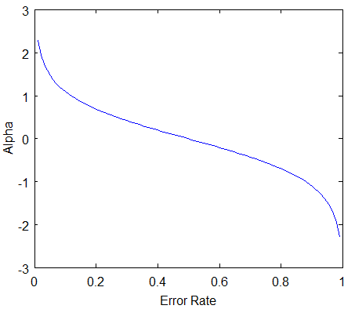


AdaBoost – Step by Step
Step 3: Calculate the Influence (Amount of say)
  F = $α_{1}M1$ + $α_{2 }M2$+ $α_{3}M3$
  M1 – 100% ( LB ) , M2 – 50% , M3 – 0% (HB) : Which model to be trusted most?
  Amount of say

Slide 13
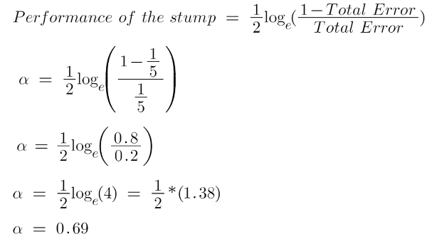
AdaBoost – Step by Step
Step 3: Calculate the Influence (Amount of say)
Total error = the summation of all the sample weights of misclassified data points. So, total error will always be between 0 and 1. 0 Indicates perfect stump, and 1 indicates horrible stump.
Here in our dataset, let’s assume there is 1 wrong output, so our total error will be 1/5, and the alpha (performance of the stump) will be:

Slide 14
AdaBoost – Step by Step
Step 4: Updating Weights of data points
The wrong predictions will be given more weight, whereas the correct predictions weights will be decreased. Now when we build our next model after updating the weights, more preference will be given to the points with higher weights.
After finding the importance of the classifier and total error, we need to finally update the weights, and for this, we use the following formula:
The amount of, say (alpha) will be negative when the sample is correctly classified.
The amount of, say (alpha) will be positive when the sample is miss-classified.

Slide 15
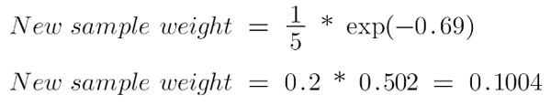
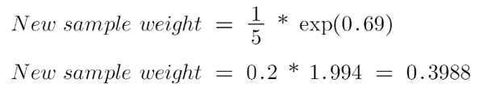
AdaBoost – Step by Step
Step 4: Updating Weights of data points
There are four correctly classified samples and 1 wrong. Here, the sample weight of that datapoint is 1/5, and the amount of say/performance of the stump of Gender is 0.69.
New weights for correctly classified samples are:
For wrongly classified samples, the updated weights will be:

Slide 16
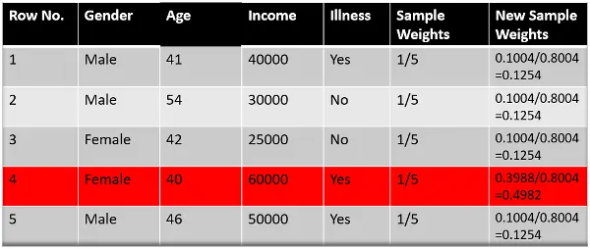
AdaBoost – Step by Step
Step 5: Normalize the weights

Slide 17
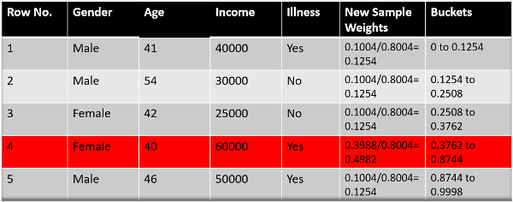
AdaBoost – Step by Step
Step 6: Decrease Errors
We need to make a new dataset to see if the errors decreased or not. For this, we will remove the “sample weights” and “new sample weights” columns and then, based on the “new sample weights,” divide our data points into buckets.

Slide 18
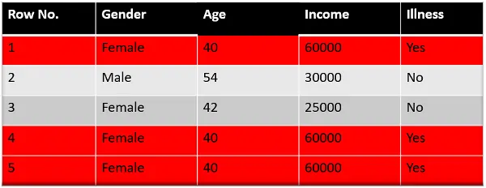
AdaBoost – Step by Step
Step 7: New Dataset
selects random numbers from 0-1. Since incorrectly classified records have higher sample weights, the probability of selecting those records is very high.
Suppose the 5 random numbers our algorithm take is 0.38,0.26,0.98,0.40,0.55.
Now we will see where these random numbers fall in the bucket, and according to it, we’ll make our new dataset shown below.

Slide 19
AdaBoost – Step by Step
Step 8: Repeat Previous Steps
  Assign equal weights to all the data points.
  Find the stump that does the best job classifying the new collection of samples by finding their Gini Index and selecting the one with the lowest Gini index.
  Calculate the “Amount of Say” and “Total error” to update the previous sample weights.
  Normalize the new sample weights.
  Iterate through these steps until and unless a low training error is achieved.

Slide 20
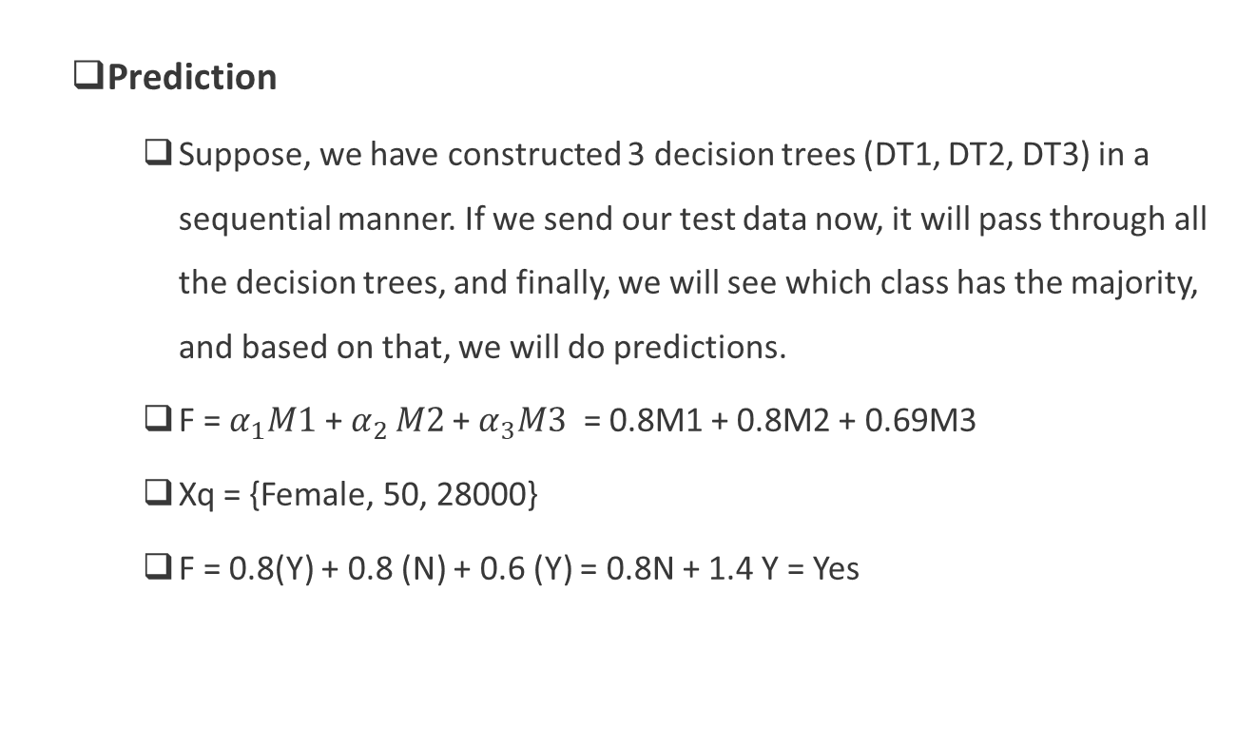
AdaBoost – Step by Step
  Prediction
    Suppose, we have constructed 3 decision trees (DT1, DT2, DT3) in a sequential manner. If we send our test data now, it will pass through all the decision trees, and finally, we will see which class has the majority, and based on that, we will do predictions.
    F = $α_{1}M1$ + $α_{2 }M2$+ $α_{3}M3$ = 0.8M1 + 0.8M2 + 0.69M3
    Xq = {Female, 50, 28000}
    F = 0.8(Y) + 0.8 (N) + 0.6 (Y) = 0.8N + 1.4 Y = Yes

Slide 21
Code
  https://github.com/campusx-official/bagging-ensemble
  https://github.com/campusx-official/100-days-of-machine-learning/blob/main/day65-random-forest/bagging_vs_random_forest.ipynb
  https://github.com/campusx-official/100-days-of-machine-learning/blob/main/day65-random-forest/random_forest_demo.ipynb
  https://scikit-learn.org/stable/modules/generated/sklearn.ensemble.RandomForestClassifier.html
  https://github.com/campusx-official/100-days-of-machine-learning/blob/main/day65-random-forest/code-example-random-forest.ipynb
  https://github.com/campusx-official/100-days-of-machine-learning/tree/main/day66-adaboost

Slide 22
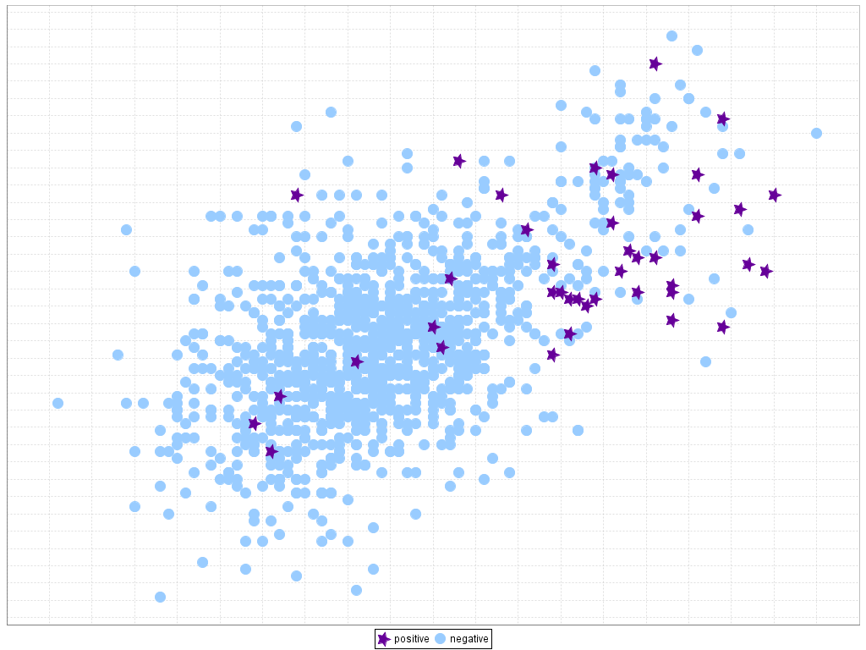
Classification of Class-Imbalanced Data Sets
Traditional methods assume a balanced distribution of classes and equal error costs. But in real world situations, we may face imbalanced data sets, which has rare positive examples but numerous negative ones.
Medical diagnosis: Medical screening for a condition
is usually performed on a large population of people
without the condition, to detect a small minority
with it (e.g., HIV prevalence in the USA is ~0.4%)
Fraud detection: About 2% of credit card accounts
are defrauded per year. (Most fraud detection domains are heavily imbalanced.)
Product defect, accident (oil-spill), disk drive failures, etc.

Slide 23
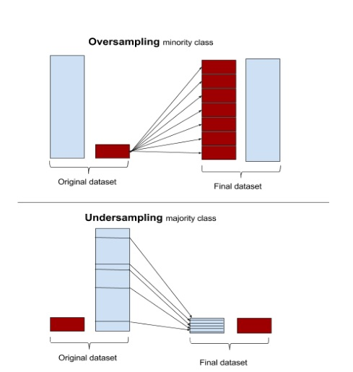
Classification of Class-Imbalanced Data Sets
Typical methods on imbalanced data (Balance the training set)
  Oversampling: Oversample the minority class.
  Under-sampling: Randomly eliminate tuples from majority class
  Synthesizing: Synthesize new minority classes

Slide 24
Classification of Class-Imbalanced Data Sets
Typical methods on imbalanced data (At the algorithm level)
  Class weight adjusting: Since false negative costs more than false positive, we can give larger weight to false negative
  Ensemble techniques: Ensemble multiple classifiers introduced in the following chapter
  Threshold moving: Move the decision threshold, t, so that the rare class tuples are easier to classify, and hence, less chance of costly false negative errors

Slide 25
Classification of Class-Imbalanced Data Sets
Can we use Accuracy to evaluate imbalanced data classifier?
Accuracy simply counts the number of errors. If a data set has 2% positive labels and 98% negative labels, a classifier that map all inputs to negative class will get an accuracy of 98%!

